Slide 1
ANALYSIS OF SUPERSTORE DATASET
Presented By:-
Swapnil Pal
Department of Computer Science & Engineering, Uns.i.e.t., Veer Bahadur Singh Purvanchal University

Slide 2
OUTLINE
Problem Statement (Should not include solution)
Proposed System/Solution
System Development Approach (Technology Used)
Algorithm & Deployment
Result
Conclusion
Future Scope
References

Slide 3

Problem Statement
To create a data analytical report for comprehensive analysis of the Sample Superstore dataset to gain valuable insights into Sales trends and Profitability of the store.
Sales Analysis: Analyze sales metrics, trends, and factors influencing sales fluctuations.
Profit Analysis: Analyze the profit and factors affecting profit of various items in the store.The Superstore dataset encompasses a wide range of information, including sales data, customer demographics, product categories, and geographical regions. By leveraging this dataset, our objective is to identify areas for improvement and provide data-driven recommendations to optimize the performance of the store.

Slide 4
Proposed Solution
PURPOSE: The purpose of the project is to perform Descriptive Data Analysis on Superstore data to gather relevant insights regarding sales and profit of the superstore-
Extract, Transform and Load (ETL) the data
Perform Exploratory Data Analysis (EDA) on the dataset.
GOAL:
Perform Descriptive Analysis of the ‘Sample Superstore’ Dataset using Python.
Highlight the insights regarding Sales and Profit of the Superstore as gathered from analyzing the data.
Tools Used: Python and libraries- NumPy, Pandas, Matplotlib and Seaborn

Slide 5
Proposed Solution
Objective :-
Understand, clean and visualize the dataset to gain insights from the data
Analyze the Sales and Profit based on different regions, categories and other parameters, that is-
Analyze sales patterns in different regions and cities to identify the highest-selling areas.
Determine the top-selling categories and sub-categories within the Superstore dataset.
Assess the profitability of different products and identify the most profitable areas.
Find the Cities, States and Regions having maximum Profit and maximum Sales.
Provide data-driven insights and recommendations for optimizing sales and improving profitability.

Slide 6
System Approach
The "System Approach" section outlines the overall strategy and methodology for developing and implementing the rental bike prediction system. Here's a suggested structure for this section:
System requirements:
Windows 11 operating system
8GB RAM
i3 processor
Library required to build the model:
IBM Watson Studio
Python and libraries- NumPy, Pandas, Matplotlib and Seaborn

Slide 7
Algorithm & Deployment
The project involved a comprehensive analysis of the Superstore dataset to gain insights into sales trends and profitability of the Superstore. This analysis utilized various Python libraries like NumPy, Pandas, statistical and data mining techniques and visualization tools such as Matplotlib and Seaborn to efficiently analyze the Superstore dataset.
Value Proposition: The analysis provides data-driven recommendations for decision making to -
□
□
□
optimize sales,
improve profitability, and
inform business strategies for personalized marketing.
The use of Python libraries and visualization tools enhances the efficiency and effectiveness of the analysis by making it easily interpretable.

Slide 8
Algorithm & Deployment
□ The analysis was tailored to the specific requirements of the Superstore dataset.
Use of advanced Visualization Tools:
In this project, I have used advanced visualization libraries like Matplotlib and Seaborn to emphasize
on the uniqueness of my solution by presenting it in a visually appealing manner such that it provides clear understanding of the insights to the end users.
Descriptive Analysis & EDA:
This project also utilizes the various techniques of Descriptive Analytics and Exploratory Data Analysis to summarize and present the key insights regarding Sales and Profit of the Superstore.

Slide 9
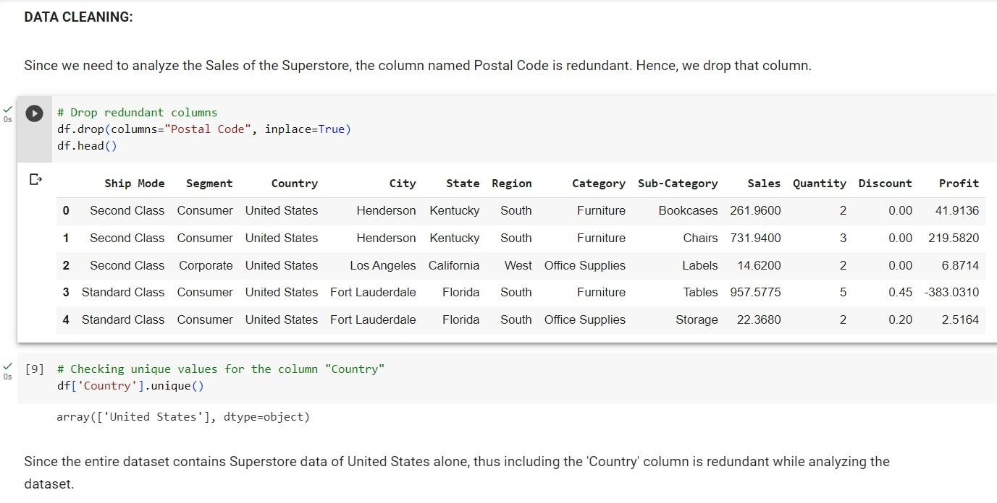
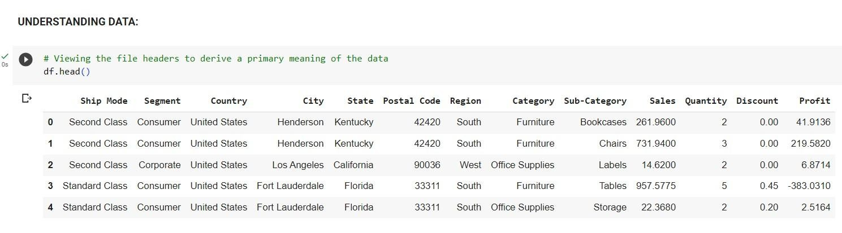
Algorithm & Deployment
Code Snippets: Here are a few code snippets from the project to demonstrate the data loading, cleaning, and transformation processes. These snippets showcases the use of Python libraries such as Pandas, NumPy, and Matplotlib for data manipulation and visualization in this project.

Slide 10
Algorithm & Deployment
Users deployment :-
Store managers and executives: The insights from the analysis can guide data-driven decision- making and strategic planning to optimize store operations.
Sales and marketing teams: The analysis provides valuable information for designing effective sales and marketing strategies based on customer demographics, preferences and buying patterns to develop targeted marketing campaigns and improve customer engagement.
Financial analysts and stakeholders: The analysis offers insights into profit margins and can enhance financial decision-making for stakeholders of the superstore.

Slide 11
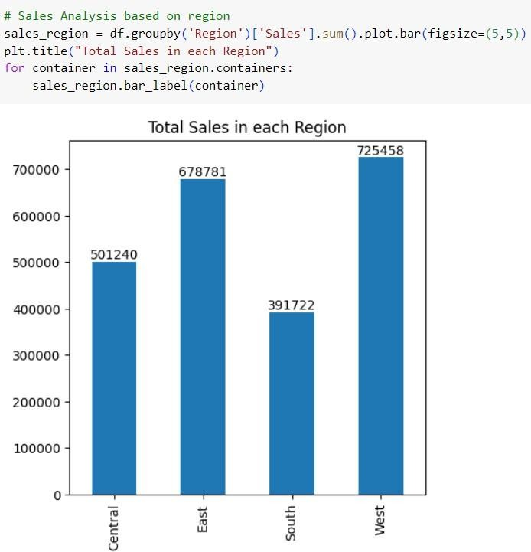
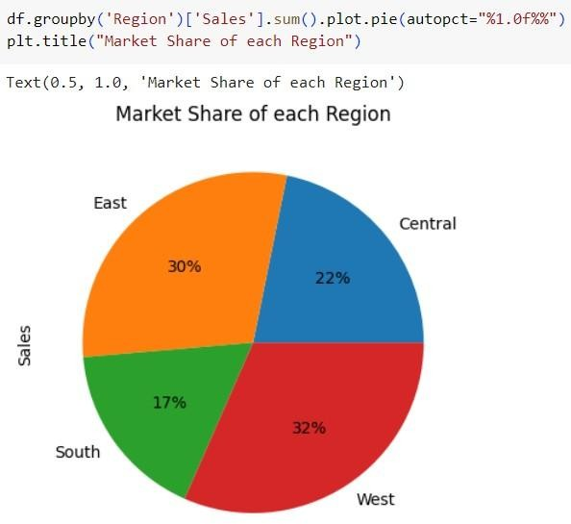
RESULT
Exploratory Data Analysis (EDA):
This comprises mainly two basis of analysis –
Sales Analysis:

Slide 12
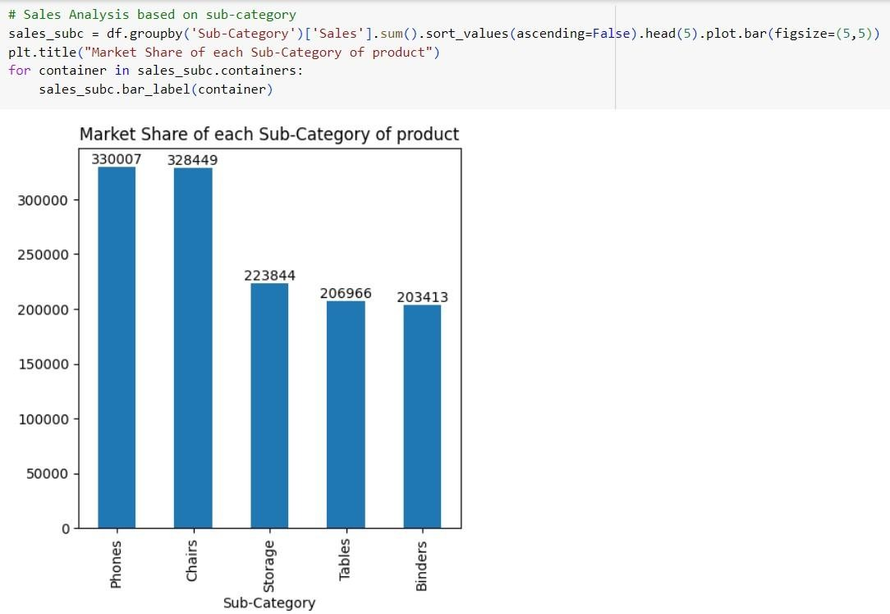
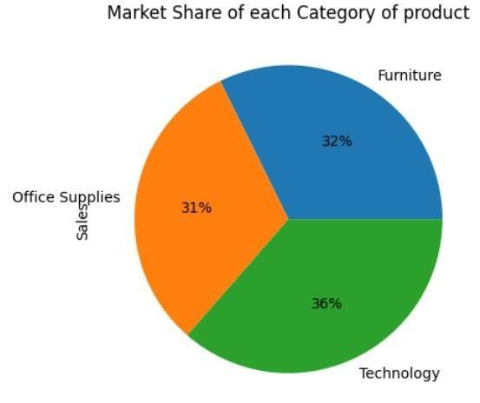
Result
Exploratory Data Analysis (EDA):
Sales Analysis:

Slide 13
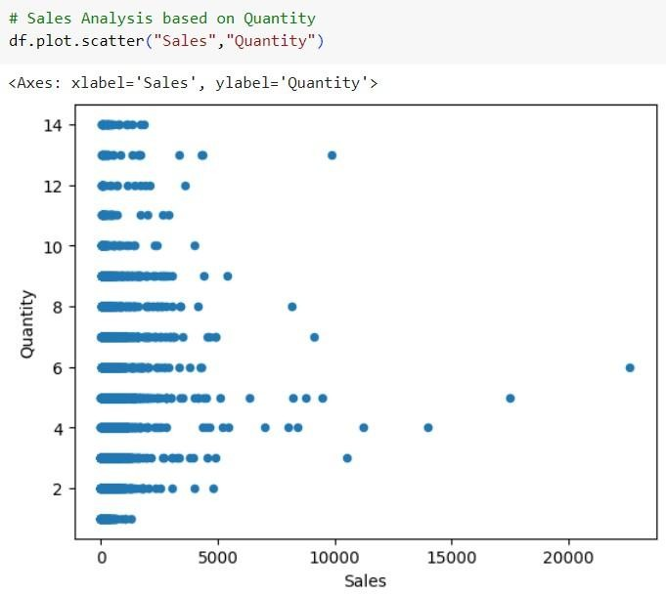
Result
Exploratory Data Analysis (EDA):
Sales Analysis:

Slide 14
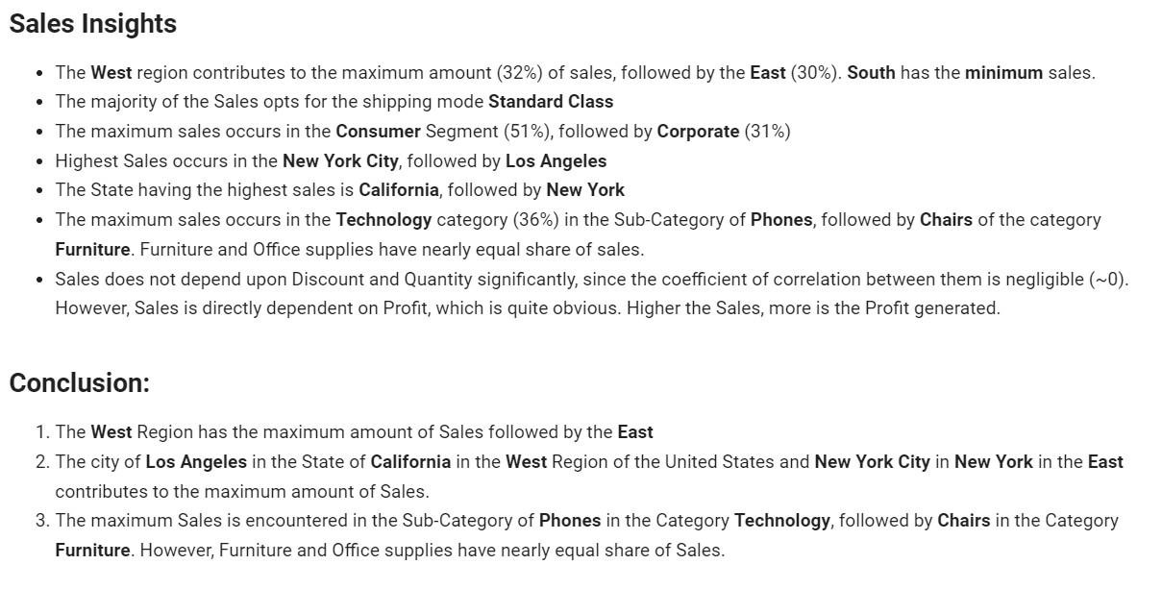
RESULT
Exploratory Data Analysis :-
Sales Analysis Insights:

Slide 15
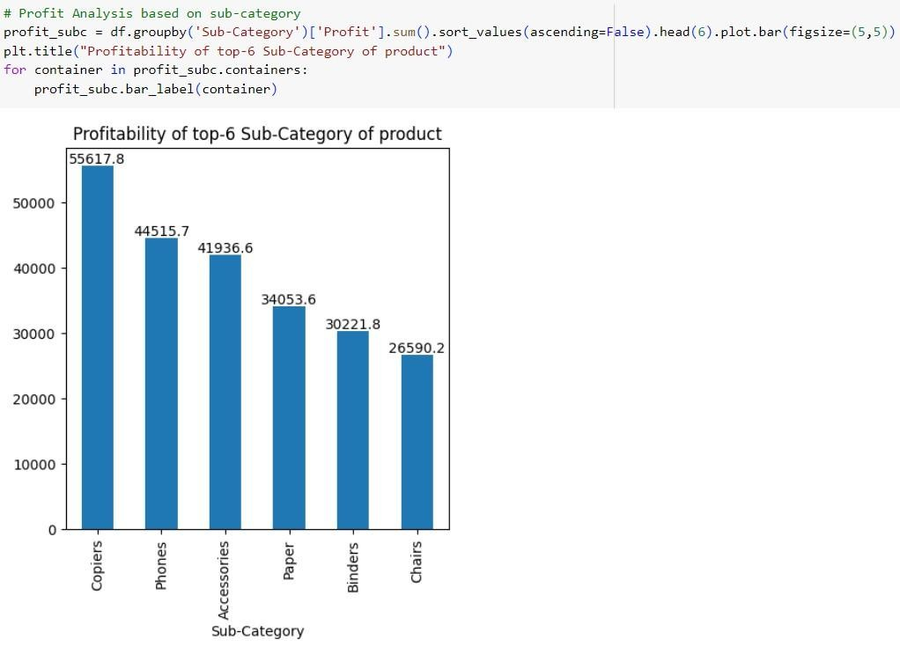
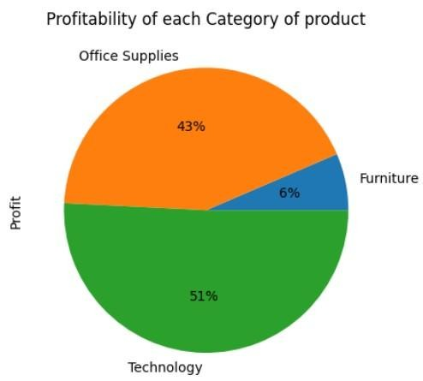
RESULT
□ Exploratory Data Analysis (EDA): This comprises of mainly two basis of analysis –
Profit Analysis:

Slide 16
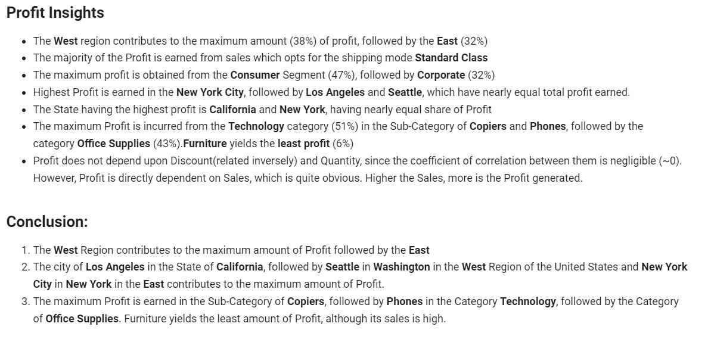
RESULT
Exploratory Data Analysis (EDA):
Profit Analysis Insights:

Slide 17
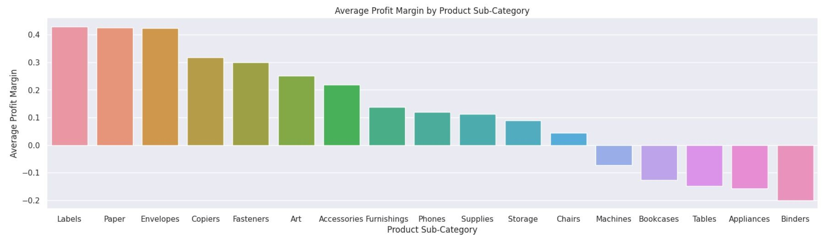
RESULT
□ Data Visualization:
Advanced data visualization techniques using tools like Python libraries (e.g., Matplotlib, Seaborn)
were used to create visually appealing and informative charts and graphs. These visualizations facilitated the effective interpretation of the analysis results and provided a clear understanding of key findings.

Slide 18
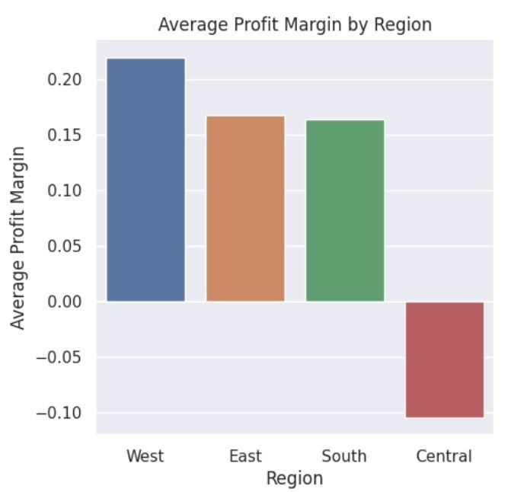
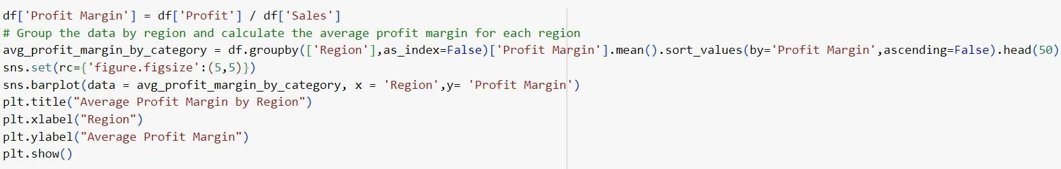
RESULT
These modelling techniques formed the pillars of the Project – Analysis of Superstore Dataset for Data Analytics, ensuring a systematic and data-driven approach to extract valuable insights from the dataset.

Slide 19
Conclusion
Key Insights: The key findings of the Sales and Profit Analysis are summarized, including the highest selling regions, cities, and sub-categories, as well as the most profitable areas-
Sale of products in the Technology Category results in Maximum Profit Margin, more
specifically Copiers, Fasteners, Accessories and Phones, followed by Office Supplies including Labels, Papers and Envelopes. Chairs are the only product in the Furniture Category which is profitable, other products of this category results in Loss.
The Segment- Home Office is the most profitable, followed by Corporate.
Sales in the West Region has the Highest Profitability, followed by the East while that in the Central Region suffers the Highest Loss.

Slide 20
Conclusion
Actionable insights: Actionable insights derived from the analysis are presented, highlighting the areas where optimization opportunities exists for sales improvement and profitability enhancement –
To ensure Maximum Profit, the production in the Technology Sector must be upgraded so that the products mentioned above are available to the customers in required quantity so as to always remain ahead of the Market Demand.
Suitable actions must be taken ensure Profit in the Furniture Category for products other than Chairs or else the cost of production of those commodities must be reduced.
More products of the Segment- Home Office must be produced so as to ensure abundant supply and maximum profit of the Superstore.
The Sales in the Central Region of the United States must be inspected for the cause of overall Loss and suitable steps must be taken to rectify the same to ensure Profit

Slide 21
Conclusion
Customized Solution: The presentation emphasizes on the significance of customized solutions based on data-driven analysis to achieve better business outcomes –
The city of Los Angeles in the State of California in the West Region of the United States and New York City in New York in the East contributes to the maximum amount of Sales. Thus, proper infrastructure, machinery and production must be especially ensured in the Superstore in these cities to facilitate higher Sales of Profit-earning commodities.
The city of Los Angeles in the State of California, followed by Seattle in Washington in the West Region of the United States and New York City in New York in the East contributes to the maximum amount of Profit. Thus, higher production must be ensured for the Superstores in these areas so as to ensure Maximum Profit from the sale of products here.

Slide 22
Future scope
Superstore dataset offers valuable insights for business improvement. Here are some future scope areas based on existing analyses:
Sales Performance Optimization:
Implement targeted marketing campaigns for high-performing product categories.
Optimize inventory management for top-selling products using real-time sales data.
Customer Segmentation:
Develop personalized marketing strategies based on customer demographics.
Identify customer segments for tailored promotions and engagement.
Geographic Strategies:
Address disparities in regional sales performance by implementing region-specific initiatives.
Utilize geographical mapping capabilities to visualize regional trends.

Slide 23
References
IBM Cloud Document.
Chat gpt
Google Kaggle datasets
IBM Watson Studio
Git hub

Slide 24
THANK YOU
RELEVANT LINKS
GitHub Repository Link:
https://github.com/pranita28Dane/IBM-Internship-Project-for-Data-Analytics
Dataset Link:
https://www.kaggle.com/datasets/bravehart101/sample-supermarket-dataset
Source Code (Google Colab): https://colab.research.google.com/drive/1LjXR1NJv9cwph61yWCGNNdaAZE0iXeaR?usp=sharing

